Slide 1
Software Defined Networking (SDN) training
Module 6: Gateways

Slide 2
Copyright and terms of use
Copyright and trademarks
This training package is proprietary and confidential and is intended only for uses described in the training materials. Content and software is provided to you under a Non-Disclosure Agreement and cannot be distributed. Copying or disclosing all or any portion of the content and/or software included in such packages is strictly prohibited.
The contents of this package are for informational and training purposes only and are provided "as is" without warranty of any kind, whether express or implied, including but not limited to the implied warranties of merchantability, fitness for a particular purpose, and non-infringement.
Conditions and terms of use
Training package content, including URLs and other Internet Web site references, is subject to change without notice. Because Microsoft must respond to changing market conditions, the content should not be interpreted to be a commitment on the part of Microsoft, and Microsoft cannot guarantee the accuracy of any information presented after the date of publication. Unless otherwise noted, the companies, organizations, products, domain names, e-mail addresses, logos, people, places, and events depicted herein are fictitious, and no association with any real company, organization, product, domain name, e-mail address, logo, person, place, or event is intended or should be inferred.

Slide 3
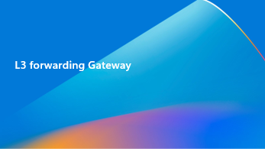
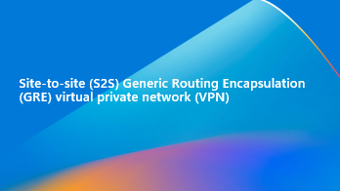

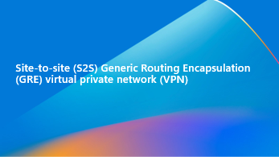


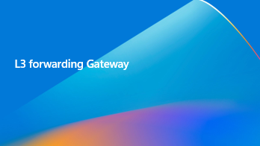
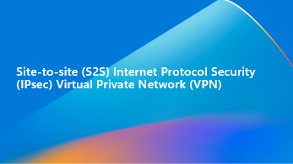


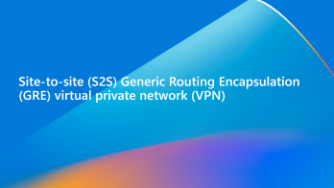
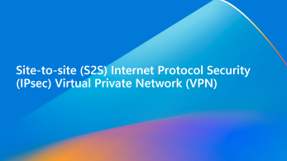


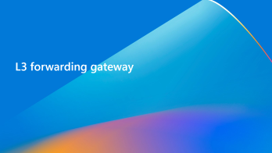
Learning objectives
By the end of this module, you will be able to:

Slide 4
Gateway overview and architecture

Slide 5
RAS Gateway overview
RAS Gateway is a software-based BGP capable router.
Leverages Windows Routing and Remote Access (RRAS).
Can route traffic between a virtual network and another network, either local or remote (on-premises).
Multiple instances of RAS Gateway virtual machines (VMs) can provide high availability and failover when combined into a pool.
Pools can be scaled up or down by adding Gateways to pools, without disrupting services.
Notes:
RAS Gateway is a software-based Border Gateway Protocol (BGP) capable router designed for cloud service providers (CSPs) and enterprises that host multitenant virtual networks using Hyper-V Network Virtualization (HNV). You can use RAS Gateway to route network traffic between a virtual network and another network, either local or remote.
RAS Gateway requires Network Controller, which performs the deployment of Gateway pools, configures tenant connections on each Gateway, and switches network traffic flows to a standby Gateway in the event of a Gateway failure.

Slide 6
Features
Site-to-Site (S2S) IPSec VPN
Connect two networks at different physical locations.
Leverages an encrypted connection using IKEv2 and IPSec protocols.
Site-to-Site (S2S) GRE Tunnels
Generic Routing Encapsulation (GRE)-based tunnels.
Enable connectivity between tenant virtual network and external networks.
Layer 3 (L3) Forwarding
Enables connectivity between physical infrastructure and virtual infrastructure.
VMs in Virtual Network can directly connect to physical network through Gateway.
Gateway acts as a router.
BGP Dynamic Routing
BGP enables automatic route learning between the sites that are connected for S2S connections (GRE and IPSec) and L3 Gateways.
BGP enables routers to automatically calculate and use valid routes to each other.
Enables fault tolerance in event of network disruption or failure.
Notes:
RAS Gateway offers a number of features for virtual private network (VPN), tunneling, forwarding, and dynamic routing.
Site-to-Site IPsec VPN
This RAS Gateway feature allows you to connect two networks at different physical locations across the Internet by using a Site-to-Site (S2S) virtual private network (VPN) connection. This is an encrypted connection, using the IKEv2 VPN protocol.
For CSPs that host many tenants in their datacenter, RAS Gateway provides a multitenant Gateway solution that allows tenants to access and manage their resources over site-to-site VPN connections from remote sites. RAS Gateway allows network traffic flow between virtual resources in your datacenter and their physical network.
Site-to-Site GRE tunnels
Generic Routing Encapsulation (GRE)-based tunnels enable connectivity between tenant virtual networks and external networks. Because the GRE protocol is lightweight and support for GRE is available on most network devices, it is an ideal choice for tunneling where encryption of data is not required.
GRE support in S2S tunnels solves the problem of forwarding between tenant virtual networks and tenant external networks using a multitenant Gateway.
Layer 3 forwarding
Layer 3 (L3) forwarding enables connectivity between the physical infrastructure in the datacenter and the virtualized infrastructure in the Hyper-V network virtualization cloud. Using L3 forwarding connection, tenant network VMs can connect to a physical network through the SDN Gateway, which is already configured in a software defined networking (SDN) environment. In this case, the SDN Gateway acts as a router between the virtualized network and the physical network.
Dynamic routing with BGP
BGP reduces the need for manual route configuration on routers because it is a dynamic routing protocol, and automatically learns routes between sites that are connected by using site-to-site VPN connections. If your organization has multiple sites that are connected using BGP-enabled routers such as RAS Gateway, BGP allows the routers to automatically calculate and use valid routes to each other in the event of network disruption or failure.
The BGP Route Reflector included with RAS Gateway provides an alternative to BGP full mesh topology that is required for route synchronization between routers.

Slide 7
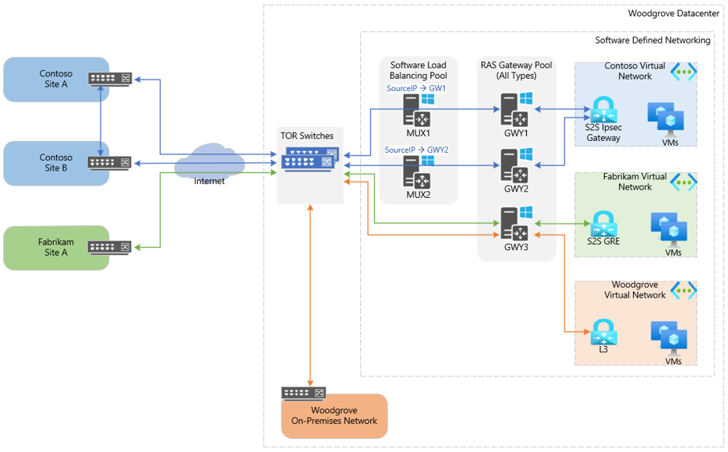
RAS Gateway deployment
Notes:
In the diagram above, there are three separate tenants that have deployed resources within respective virtual networks.
Contoso has opted to create a S2S IPsec Gateway to connect their virtual network in the CSP datacenter to their on-premises locations.
A Gateway subnet is allocated from within the Contoso Virtual Network and Virtual Network Gateway using IPsec is created. They have created multiple connections within their Virtual Network Gateway to each of their on-premises locations. A public VIP is associated with the S2S connections in which the SLB is configured to redirect the VIP to the appropriate GWY VM that is hosting the S2S connection. GWY VM will then process the IPsec payload and route across the provider network to deliver the packet the respective customer address.
Fabrikam tenant has opted to leverage a S2S GRE tunnel. Tenant, CSP and internet service provider (ISP) have established a high speed MPLS tunnel between the Tenant network and Woodgrove datacenter. BGP Peering allows routes to be automatically shared between their site and virtual network hosted in the Woodgrove datacenter. Routes are automatically configured within the dataplane, to enable direct routing using the private IP address of resources deployed within the virtual network.
Woodgrove has also decided to virtualize some of their workloads and leverage the environment as an IaaS platform. To bridge connectivity between their existing on-premises network and virtual network, they have opted to create a L3 Gateway and configure the appropriate TORs and switches within their physical network to enable the routing between networks.

Slide 8
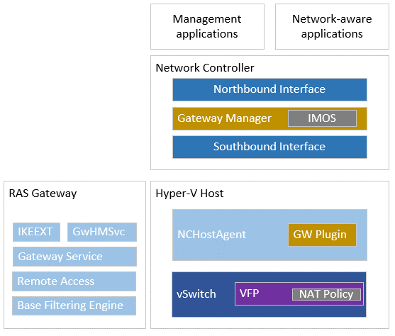
Architecture overview
Gateway architecture is composed of the following resources:
Gateway Manager Service
RAS Gateway
Gateway Health Monitoring Service
Gateway Service
Remote Access
Base Filtering Engine
IKEEXT
NC Host Agent
Gateway Plugin
Virtual Filtering Platform (VFP)

Slide 9
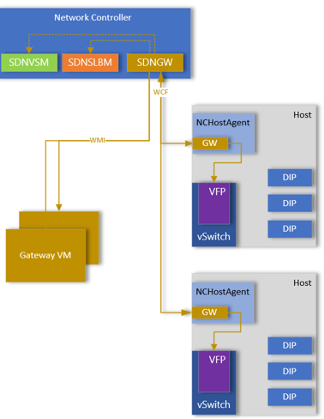
Policy configuration
SDN GWM (SDNGWM) will receive REST operations via Northbound API.
GWM will communicate with VNET and vSwitch Manager (VSM) and SLB Manager.
Gateway Manager pushes configuration to RAS Gateways using WMI.
Gateway Manager configures Gateway Plugin within NCHostAgent using WCF.
Gateway Plugin configures VFP policies directly (does not leverage OVSDB).
Notes:
Gateway Plugin is only used for FastPath scenarios. If not using FastPath tunnels, GWM will coordinate with the VNET component of SDNVSM to update the routing configuration. SDNVSM will then use its policy configuration routing method to push the route configuration into the dataplane.

Slide 10
Gateway manager
Gateway Manager Service (GWM) manages the RAS Gateway VMs.
Pushes the Gateway configuration for tunnels.
Monitors health of the Gateways and provides failover capability if Gateway is unresponsive.
In scenarios with S2S IPsec tunnels, it will configure SLB VIP to route traffic. through the SLB framework. SLB is not used for S2S GRE or L3 tunnels.
Performs route management. Routes can be learned dynamically by leveraging BGP or can be statically configured.
Notes:
Gateway manager service is a service within Network Controller that manages the RAS Gateways within the SDN fabric. It configures the Gateway configuration for the tunnels to the Gateway VMs using WMI. In addition to handling configuration goal state for the tunnels, it will monitor the Gateways and capacity. In scenarios where the Gateway is not responding to heartbeat, it will failover the connections to passive Gateway and issue a restart to the Gateway VM in attempt to restore communications.
When tenant creates a virtual Gateway, the request is sent to NB API of Network Controller, which is then passed to the Gateway Manager.
Gateway Manager is aware of all of the Gateway pools, including the capacity of each pool and every Gateway in every pool. Gateway Manager selects the correct pool and Gateway for the connection. This selection is based on the bandwidth requirement for the connection. Network Controller uses a "best fit" algorithm to pick connections efficiently in a pool.
Gateway Manager selects a RAS Gateway for the connection and provisions the necessary configuration for the connection on the Gateway. If the connection is an IKEv2 S2S connection, GWM also provisions a Network Address Translation (NAT) rule on the SLB pool; this NAT rule on the SLB pool directs connection requests from the tenant to the designated Gateway. In scenarios where the connection is S2S GRE or L3, there is no need to configure SLB as they bypass the SLB layer entirely.
If BGP routing is enabled for the connection, then BGP peering is initiated by RAS Gateway - and routes are exchanged between on-premises and cloud Gateways. The routes that are learned by BGP (or that are statically configured routes if BGP is not used) are sent to Network Controller. Network Controller then plumbs the routes down to the Hyper-V hosts upon which the tenant VMs are installed. At this point, tenant traffic can be routed to the correct on-premises site. Network Controller also creates associated policies that specify Gateway locations and plumbs them down to the Hyper-V hosts into VFP. This is typically handled by the VNET Service Module contained within the VSM service in Network Controller.

Slide 11
NC Host Agent
Gateway plugin receives communications directly with Gateway Manager via WCF.
Responsible for configuring VFP directly for tunnels leveraging FastPath which was originally introduced in Windows Server 2019 and later builds.
Responsible for health monitoring of Gateway VMs.
Notes:
Gateway plugin within NCHostAgent will communicate directly with Gateway Manager service directly over WCF.
Gateway plugin is responsible for pushing VFP policies for FastPath tunnels. FastPath engine was added and enabled by default in Windows Server 2019 and later builds.
In addition to configuring the VFP policies for FastPath scenarios, it provides health monitoring for Gateway virtual machines. This is especially true when there is heavy load on the Gateway VM and heartbeats from health monitoring service in the Gateway VM are missed during load, or during live-migration events.

Slide 12
Gateways
Provides Gateway services to one or more virtual network resources.
Represented within NC NB API as /networking/<apiVersion>/Gateways/{resourceId}.
There is no limit on the number of Gateways managed by Gateway Manager.
Gateway can be associated to a single pool.
Notes:
A Gateway resource is the computing resource that provides Gateway services to one or more virtualNetwork resources. The configuration in this resource is the generic configuration that provides Gateway services to the virtualNetwork resources.

Slide 13
Gateway resource
Property | Description
virtualGateways | Reference to a collection of tenant virtual Gateways. This helps in enumerating the tenants that are dependent on this Gateway.
virtualServer | Reference to the virtual server that acts as a Gateway.
totalCapacity | Indicates total bandwidth capacity of the Gateway when it was provisioned. This value indicates plain-text processing capacity.
connections | Indicates a reference to collection of all the connections on the Gateway.
pool | Indicates a reference to the GatewayPools resource the Gateway is part of.
networkInterfaces | Indicates the external and internal network interfaces that the Gateways resource operates on. Both references MUST be present on both read and write. The references cannot be changed after the Gateways resource is created.
networkInterfaces.external NetworkInterface | A resource reference to a network interface with precisely one IP configuration on a logical network.
networkInterfaces.internal NetworkInterface | A resource reference to a network interface without any IP configurations.

Slide 14
Gateway resource (continued)
Property | Description
type | Indicates the type of pool – All, IKEv2, GRE, or forwarding.
bgpConfig | Indicates the BGP peering information required for peering with Top-of-Rack (ToR) router for GRE Gateway.
bgpConfig.extASNumber | Extended (4-byte) Autonomous System Number (ASN) of the local BGP Router in XX.YY format.
bgpConfig.bgpPeer | Indicates information of the BGP peer.
bgpConfig.bgpPeer.peerIP | IP address of the peer, in this case the top of rack (ToR).
bgpConfig.bgpPeer.peer ExtAsNumber | Extended (4-byte) ASN of the peer BGP router in XX.YY format.

Slide 15
Gateway pools
Aggregate a set of Gateways into a single pool.
Represented within NC NB API as /networking/<apiVersion>/GatewayPools/{resourceId}.
Gateway pool consists of Gateways that provides services such as IPSec, GRE or L3 Forwarding Gateways.
Gateways can be added or removed from an existing pool.
Each tenant can be assigned or more Gateway pools from which connections are serviced.
Gateways in a Gateway pool can provide services to multiple tenants.
Every pool has ‘M’ active Gateways and ‘N’ standby Gateways for high availability.
In event of Gateway going down, ‘N’ Gateway is moved to ‘M’ active state.
Notes:
The GatewayPools resource aggregates a set of Gateways resources into a single pool. It contains an array of Gateways that provide the infrastructure needed to service VirtualGateways instances with differentiated services for tenant virtual networks.
A Gateway pool usually consists of Gateways that provide services, such as IPsec, Generic Routing Encapsulation (GRE) (RFC2784) or a Forwarding (L3) Gateway. A Gateway pool can also be created for different categories of customers or resellers. After a Gateway pool is created, Gateways of identical type and capacity can be added to the pool. Each tenant can be assigned one or more Gateway pools from which its connections are serviced. Gateways in a Gateway pool can service multiple tenants.

Slide 16
Gateway pool resource
Property | Description
type | Indicates the type of the role of Gateway VMs in the pool. The following are valid string values: s2sIPsec s2sGre forwarding ALL
greVipSubnets | Indicates the logical subnet from which VIPs for Gateways providing GRE-based network connections.
publicIPAddresses | Indicates collection of public IP address references. These are the IPs to which external connections connect to. This is optional in case Type is s2sGre.
redundantGatewayCount | Indicates the number of redundant Gateway VMs that will be used for each VirtualGateways instance to ensure its availability. For example, in a 3+1 Gateway deployment, 1 will be redundant Gateway count.
GatewayCapacityKiloBitsPerSecond | Indicates the total capacity of each Gateway in the pool in kilobits per second.
Gateways | Indicates references to collection of Gateways that comprise the Gateway pool.
VirtualGateways | Indicate references to collection of VirtualGateways that contains subscription connection information that are dependent on the pool.

Slide 17
Lab
Examine the Gateway Manager service​.
Examine the RAS Gateways​.
Examine Gateway Pools resource.

Slide 18
Knowledge check – Gateway architecture
In what version of Windows Server was FastPath introduced?
Which protocol is used to configure policies to the RAS Gateways?
What is a Gateway pool?
Notes:
See answers at end of the deck.

Slide 19
Virtual Gateways

Slide 20
Virtual Gateways
Used to define resources to enable cross-premises connectivity with virtual network.
VirtualGateway can be hosted across multiple Gateways in a Gateway pool
Represented within NC NB API as /networking/<apiVersion>/virtualGateways/{resourceId}.
Virtual Gateways contain the tenant connections and are allocated out of a Gateway subnet range of a virtual network.

Slide 21
Virtual Gateway resource
Property | Description
GatewaySubnets | Indicates collection of references to IPv4/IPv6 subnet of the VSID/Gateway subnet that includes the Gateway.
networkConnections | Indicates list of network connections that are configured for this VirtualGateways resource. See section 3.1.5.17.4 for full details on this element.
vpnConfiguration.IPv4AddressPrefixes | Indicates collection of IPv4 address pools from which VPN endpoints are assigned addresses.
vpnConfiguration.IPv4AddressPrefixes | Indicates IPv4 prefix of the pool.
vpnConfiguration.IPv4AddressPrefixes.start | Starting IPv4 address of the pool. This is required if the start and end addresses do not form a subnet.
vpnConfiguration.IPv4AddressPrefixes.end | Ending IPv4 address of the pool. This is not required if the start and end addresses form a subnet.
vpnConfiguration.IPv6AddressPrefixes | Indicates IPv6 prefix advertised to remote access VPN endpoints.

Slide 22
Virtual Gateway resource (continued)
Property | Description
vpnConfiguration.capacity | Aggregate bandwidth capacity of VPN connection in Kbps.
vpnConfiguration.Realm | Realm used to identify tenants. E.g. contoso, Woodgrove.
bgpRouters | Indicates the BGP peering information. See section 3.1.5.17.2 for full details on this element.
policyMaps | Indicates BGP policy maps. See section 3.1.5.17.3 for details.
GatewayPools | Indicates a collection of references to GatewayPools resources in which connections can be created.
routingType | Dynamic is the only support value for this field.

Slide 23
Network connections
Resource for a specific connection from virtual network to external networks.
Multiple connections can exist for virtual network with different types.
Represented within NC NB API as /networking/<apiVersion>/virtualGateways/{resourceId}/networkConnections/{resourceId}.
When connection is created, request is sent to GWM which selects the best RAS Gateway for connection placement.
GWM provisions the necessary configuration and pushes the configuration to the RAS Gateway.
Notes:
The networkConnections resource specifies a connection from virtual network to external networks. Multiple connections can exist for a given virtual network and there are different types of connections.

Slide 24
Network connections resource (common)
Property | Description
connectionType | Indicates type of connection. Valid values are: IPSec, GRE, or L3(Forwarding).
routes | An array that lists of all the routes (static and those learned via BGP) on the network Interface. Traffic matching the routes is transmitted on the network Interface.
routes.destinationPrefix | Prefix with subnet of the routes.
routes.protocol | Indicates how the route is learnt/added (static or BGP).
ConnectionStatus | Indicates administrative status of connection. Values: Enabled or Disabled.
ConnectionState | Indicates operational status of connection. Values: Connected or Disconnected.
statistics | Statistics of the connection.
ConnectionUpTime | Indicates operations up time of the connection in seconds.
ConnectionErrorReason | Indicates the reason for not being able to connect after dialing in the previous attempt.
unreachabilityReason | Indicates the reason for not being able to connect/dial in the previous attempt.
Notes:
There are a LOT of properties defined under this resource type with unique and shared properties between S2S IPsec, S2S GRE, and L3 Forwarding objects. This slide just represents some of the common shared properties between the different types of connections available. When we go into detail on the connections available, additional properties will be shared.

Slide 25
Network connections resource (common) (continued)
Property | Description
outboundKiloBitsPerSecond | Indicates maximum allowed outbound bandwidth in Kbps.
inboundKiloBitsPerSecond | Indicates maximum allowed inbound bandwidth in Kbps.
Gateway | Reference of the Gateway on which the connection exists.
Notes:
There are a LOT of properties defined under this resource type with unique and shared properties between S2S IPsec, S2S GRE, and L3 Forwarding objects. This slide just represents some of the common shared properties between the different types of connections available. When we go into detail on the connections available, additional properties will be shared.

Slide 26
BGP routing
Border Gateway Protocol (BGP) Route Reflector is included with RAS Gateway.
Logical entity that sits in the control plane between the RAS Gateways and Network Controller.
BGP is a dynamic routing protocol that eliminates the need for manual route configuration.
Routes are automatically learned between BGP peers.
Does not actively participate in traffic routing.
Notes:
BGP reduces the need for manual route configuration on routers because it is a dynamic routing protocol, and automatically learns routes between sites that are connected by using site-to-site VPN connections. If your organization has multiple sites that are connected using BGP-enabled routers such as RAS Gateway, BGP allows the routers to automatically calculate and use valid routes to each other in the event of network disruption or failure.
The BGP Route Reflector included with RAS Gateway provides an alternative to BGP full mesh topology that is required for route synchronization between routers. A Route Reflector in a Software Defined Networking deployment is a logical entity that sits on the control plane between the RAS Gateways and the Network Controller. It does not, however, participate in data plane routing.

Slide 27
How route reflector works
Route Reflector connects with all other routers, referred to as BGP Route Reflector clients.
When a Virtual Gateway is provisioned onto a RAS Gateway, a BGP router is created by default (regardless if customer leverages BGP) for the tenant.
First BGP Router for tenant Virtual Gateway becomes the Route Reflector.
In scenarios where Virtual Gateway has multiple connections across multiple RAS Gateways, BGP Router is created on each RAS Gateway for the Virtual Gateway(s).
BGP Routers then do iBGP for route advertisement.
The Route Reflector learns all routes, calculates best routes, and redistributes the best routes to its BGP clients.
BGP Route Reflector leverages WMI and pushes changes whenever route update happens to Gateway Manager.
eBGP is performed between the on-premises Gateway device and the Route Reflector if tenant opts to leverage BGP for dynamic route learning.
Notes:
With full mesh synchronization, all BGP routers must connect with all other routers in the routing topology. When you use Route Reflector, however, the Route Reflector is the only router that connects with all of the other routers, called BGP Route Reflector clients, thereby simplifying route synchronization and reducing network traffic. The Route Reflector learns all routes, calculates best routes, and redistributes the best routes to its BGP clients.
You can configure an individual tenant's remote access tunnels to terminate on more than one RAS Gateway virtual machine (VM). This provides increased flexibility for Cloud Service Providers (CSPs) in situations where one RAS Gateway VM cannot meet all of the bandwidth requirements of the tenant connections.
This capability, however, introduces the additional complexity of route management and effective synchronization of routes between the tenant remote sites and their virtual resources in the cloud datacenter. Providing tenants with connections to multiple RAS Gateways also introduces additional complexity in configuration at the enterprise end, where each tenant site will have separate routing neighbors.
A BGP Route Reflector in the control plane addresses these problems and makes the CSP internal fabric deployment transparent to the enterprise tenants.

Slide 28
Knowledge check – Virtual Gateway
What is a Virtual Gateway?
You can only have a single Network Connection per Virtual Gateway?
What route types exists?
Notes:
See answers at end of the deck.

Slide 29
Site-to-site (S2S) Internet Protocol Security (IPsec) Virtual Private Network (VPN)

Slide 30
S2S VPN overview
Allows you to connect two networks at different physical locations.
Uses encrypted traffic between two endpoints making it secure over public internet.
Leverages IPsec and IKEv2. IKEv1 (policy-based routing) is not supported.
IKEv2 leverages Main Mode and Quick Mode policies to securely setup a tunnel between endpoints.

Slide 31
What is IPsec?
The Encapsulating Security Payload (ESP) RFC4303 and the Authentication Header (AH) RFC4302 are the mechanisms for applying cryptographic protection to data being sent over an IPsec Security Association (SA) RFC4301.
To establish an IPsec tunnel, we leverage a protocol called IKEv2 (Internet Key Exchange). There are two phases to build an IPsec tunnel.
Main Mode (phase 1)
Quick Mode (phase 2)
In main mode, two peers negotiate encryption, authentication, hashing and other protocols.
Collection of parameters the two devices will use is called Security Association.
Main mode is only used for management traffic and to establish secure method to establish Quick Mode tunnel.
Once Quick Mode is established, we have IPsec tunnel which protects the user data.
Notes:
The Encapsulating Security Payload (ESP) (RFC 4303) and the Authentication Header (AH) (RFC 4302) are the mechanisms for applying cryptographic protection to data being sent over an IPsec Security Association (SA) (RFC 4301).
Establish an IPsec Tunnel
To establish an IPsec tunnel, we leverage a protocol called IKEv2 (Internet Key Exchange). There are two phases to build an IPSec tunnel.
Main Mode (phase 1)
Quick Mode (phase 2)
In IKE phase 1, two peers will negotiate the encryption, authentication, hashing and other protocols they wantt o use. In this phase an ISAKMP (Internet Security Association and Key Management Protocol) session is established.
The collection of parameters that the two device will use is called a SA (Security Association).
The IKE phase 1 tunnel is only used for management traffic. This tunnel is used as a secure method to establish the second tunnel called the IKE phase 2 tunnel, or IPSec tunnel. Keep-alive traffic related to management traffic is also sent over the phase 1 tunnel.
Once the IKE phase 2 is completed, we have an IPSec tunnel that can be used to protect the user data.

Slide 32
What is Internet Key Exchange version 2 (IKEv2)?
Performs mutual authentication between two endpoints.
Establishes an IKE Security Association (SA) that includes shared secret information.
See RFC 8221 for technical details on IKEv2.
Notes:
What is Internet Key Exchange version 2 (IKEv2)?
IP Security (IPsec) provides confidentiality, data integrity, access control, and data source authentication to IP datagrams. These services are provided by maintaining shared state between the source and the sink of an IP datagram. This state defines, among other things, the specific services provided to the datagram, which cryptographic algorithms will be used to provide the services, and the keys used as input to the cryptographic algorithms.
Establishing this shared state in a manual fashion does not scale well. Therefore, a protocol to establish this state dynamically is needed.
IKEv2 performs mutual authentication between two parties and establishes an IKE Security Association (SA) that includes shared secret information that can be used to efficiently establish SAs for Encapsulating Security Payload (ESP) [ESP] or Authentication Header (AH) [AH] and a set of cryptographic algorithms to be used by the SAs to protect the traffic that they carry.

Slide 33
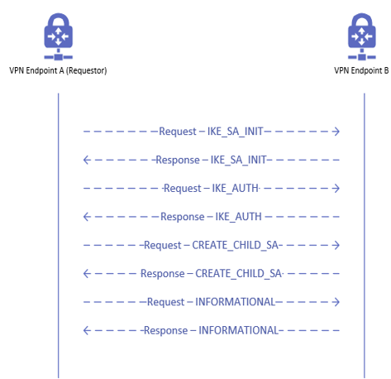
IKEv2 exchange
IKE_SA_INIT
Initial exchange between peers
Negotiates security parameters
Sends Diffie-Hellman values
IKE_AUTH
Transmits identities
Establishes the first AH or ESP Child-SA
CREATE_CHILD_SA
Used to create additional SAs
INFORMATIONAL
General maintenance operations of SA
Notes:
IKE_SA_INIT Exchange
IKE_SA_INIT is the initial exchange that occurs that allows the peers to establish a secure channel. Once it completes the exchange, all further exchanges are encrypted. This exchange needs to complete successfully before the next exchange type can occur. It performs three functions as part of this exchange:
Negotiates the security parameters
Sends nonces
Sends the Diffie-Hellman values
IKE_AUTH Exchange
After the IKE_SA_INIT exchange has completed, the IKEv2 SA is encrypted however we are still pending authentication of the remote peer. This exchange is used to authenticate the remote peer and create the first IPSec SA. There are several authentication methods available such as Pre-Shared Key (PSK), RSA certificates (RSA-SIG), Elliptic Curve Digital Signature Algorithm certificates (ECDSA-SIG) or EAP. In addition to the authentication method and payloads exchanged, it will include the SA and Traffic Selector payloads that describe the IPSec SA to be created. Just like the IKE_SA_INIT Exchange, this exchange must complete successfully before the other two exchanges can be called. Functions that this exchange performs:
Transmits the identities
Proves it has knowledge of the secrets related to the identities
Establishes the first AH and/or ESP CHILD-SA
CREATE_CHILD_SA Exchange - Used to create additional Sas
INFORMATIONAL Exchange
These packet exchanges are related to the maintenance of the SA. These include:
Deletion of SAs
Report any error conditions
Check for liveliness of the SA
Other related SA maintenance operations

Slide 34
Network connections resource (S2S IPsec)
Property | Description
ipsecConfiguration | Details of IPsec configuration.
ipsecConfiguration.authenticationMethod | Indicates authentication method. PSK is the only valid value.
ipsecConfiguration.sharedsecret | The shared secret used for this NetworkConnection. Note this is write-only property and the value of this field is not shown in the GET of networkConnections.
ipsecConfiguration.mainMode | Main mode IPsec configuration details, as specified in [RFC2409].
ipsecConfiguration.quickMode | Quick mode IPsec configuration.
ipsecConfiguration.localVpnTrafficSelector | Indicates collection of IPsec TrafficSelectors on the host side.
ipsecConfiguration.remoteVpnTrafficSelector | Indicates collection of IPsec TrafficSelectors on the tenant side.
SourceIPAddress | Indicates sourceIPAddress used by the tunnel configured within SDN.
destinationIpAddress | Indicates destination IP address of the tunnel. This is the external on-premises VPN device IP address.
Notes:
These are properties that are available that are related specifically to S2S IPsec tunnels. There are other settings contained within objects such as mainMode (phase 1) and quickMode (phase 2) and traffic selectors.

Slide 35
High availability for S2S IPsec
GWM stores the configuration of all deployed virtual Gateways.
When RAS Gateway fails, it impacts the connections hosted on the RAS Gateway.
GWM detects the failures, and performs:
Selects an empty standby RAS Gateway and converts the RAS Gateway to active.
Pushes configuration of connections to the active RAS Gateway.
Changes the NAT mappings on the SLB pool to point to new RAS Gateway.
IPsec connections will perform Main Mode / Quick Mode negotiations to re-establish tunnel.
If using BGP, peering will be re-established, and routes advertised.
Notes:
Network Controller stores the configuration of all deployed active Gateways. Configuration consists of connection settings and routing settings.
When a Gateway fails, (VM failure, Hyper-V failure, service failures) it impacts tenant connections on the Gateway, as well as tenant connections that are located on other Gateways but whose RR resides on the failed Gateway. The down time of the latter connections is less than the former. When Network Controller detects a failed Gateway, it performs the following tasks:
Removes the routes of the impacted connections from the compute hosts.
Removes the Hyper-V Network Virtualization policies on these hosts.
Selects a standby Gateway, converts it into an active Gateway, and configures the Gateway.
Changes the NAT mappings on the SLB pool to point connections to the new Gateway.
Simultaneously, as the configuration comes up on the new active Gateway, the IKEv2 S2S connections and BGP peering are re-established. The connections and BGP peering can be initiated by either the cloud Gateway or the on-premises Gateway. The Gateways refresh their routes and send them to Network Controller. After Network Controller learns the new routes discovered by the Gateways, Network Controller sends the routes and the associated Hyper-V Network Virtualization policies to the Hyper-V hosts where the VMs of the failure-impacted tenants reside. This Network Controller activity is similar to the circumstance of a new connection setup, only it occurs on a larger scale.

Slide 36
Lab
Create the Fabrikam virtual network and subnets​.
Create the virtual Gateway​.
Create the S2S IPsec connection​.
Configure the Fabrikam-GW01 Gateway​.
Examine the Virtual Gateways resource​.
Examine the Gateways and Gateway pools.
Examine the VFP (Azure Virtual Filtering Platform) policies applied to Fabrikam-VM1.
Enable IPSec FastPath.

Slide 37
Knowledge check
What is one of the primary reasons to leverage the S2S IPSec VPN?​
What two VPN types must be established before traffic can flow?​
Traffic for S2S IPSec VPNs are routed through the SLB MUXs.
Notes:
See answers at end of the deck.

Slide 38
Site-to-site (S2S) Generic Routing Encapsulation (GRE) virtual private network (VPN)

Slide 39
What is GRE?
Generic Routing Encapsulation (GRE) is a lightweight tunneling protocol.
Microsoft GRE can encapsulate both IPv4 and IPv6 traffic.
RFC 2890 compliant, making it interoperable with other common devices.
GRE based tunnels enable connectivity between tenant virtual networks and external networks.
Ideal for tunneling where encryption of data is not required.

Slide 40
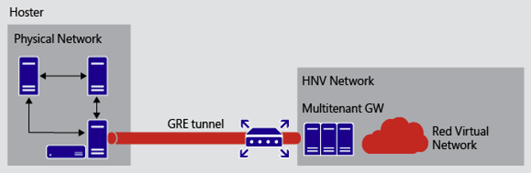
GRE routing
Enables routing between virtual network and physical network.
Layer 3 traffic is routed between the networks.
Integrating BGP between the GRE devices allows for dynamic routing.
Notes:
This scenario enables a scalable way to provide access from tenant virtual networks to tenant physical networks located on the hosting service provider premises. A GRE tunnel endpoint is established on the multitenant Gateway, the other GRE tunnel endpoint is established on a third-party device on the physical network. Layer-3 traffic is routed between the virtual machines in the virtual network and the third-party device on the physical network.

Slide 41
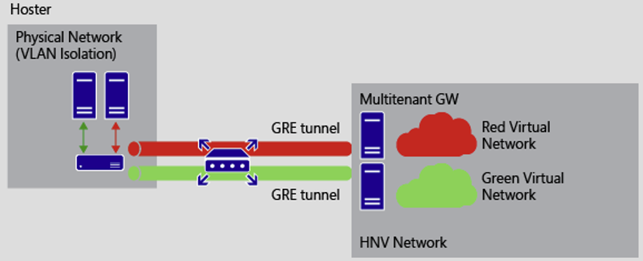
GRE routing with VLAN
VLANs can be integrated with virtual networks.
Provides isolation of traffic once traffic has entered physical network.
Notes:
This scenario enables a scalable way to provide access from tenant virtual networks to tenant physical networks located on the hosting service provider premises. A GRE tunnel endpoint is established on the multitenant Gateway, the other GRE tunnel endpoint is established on a third-party device on the physical network. Layer-3 traffic is routed between the virtual machines in the virtual network and the third-party device on the physical network.

Slide 42
Network connections resource (S2S GRE)
Property | Description
SourceIPAddress | Indicates sourceIPAddress used by the tunnel.
destinationIpAddress | Indicates destination IP address of the tunnel.
greConfiguration | Indicates details of GRE configuration
greConfiguration.greKey | Indicates GRE key.

Slide 43
High availability for S2S GRE
During Gateway deployment, every Gateway VM is assigned a VIP for GRE high availability.
VIPs are assigned only to RAS Gateways within Gateway Pool that allows GRE.
VIPs are advertised to the TORs directly by the RAS Gateways.
Traffic is routed directly from TOR to RAS Gateways (bypassing SLB infrastructure).
When Gateway failover happens, Gateway Manager copies the configuration data for the network connection as well as the VIP address to new standby RAS Gateway.
VIP is then advertised to the TOR from the new RAS Gateway.
If BGP enabled, route advertisement will occur automatically between the networks.
Notes:
The process of RAS Gateway failover response by Network Controller - including failure detection, copying connection and routing configuration to the standby Gateway, failover of BGP/static routing of the impacted connections (including the withdrawal and re-plumbing of routes on compute hosts and BGP re-peering), and reconfiguration of Hyper-V Network Virtualization policies on compute hosts - is the same for GRE Gateways and connections. The re-establishment of GRE connections happens differently, however, and the high availability solution for GRE has some additional requirements.
At the time of Gateway deployment, every RAS Gateway VM is assigned a Dynamic IP address (DIP). In addition, every Gateway VM is also assigned a virtual IP address (VIP) for GRE high availability. VIPs are assigned only to Gateways in pools that can accept GRE connections, and not to non-GRE pools. The VIPs assigned are advertised to the top of rack (TOR) switches using BGP, which then further advertises the VIPs into the cloud physical network. This makes the Gateways reachable from the remote routers or third-party devices where the other end of the GRE connection resides. This BGP peering is different than the tenant-level BGP peering for the exchange of tenant routes.
At the time of GRE connection provisioning, Network Controller selects a Gateway, configures a GRE endpoint on the selected Gateway, and returns back the VIP address of the assigned Gateway. This VIP is then configured as the destination GRE tunnel address on the remote router.
When a Gateway fails, Network Controller copies the VIP address of the failed Gateway and other configuration data to the standby Gateway. When the standby Gateway becomes active, it advertises the VIP to its TOR switch and further into the physical network. Remote routers continue to connect GRE tunnels to the same VIP and the routing infrastructure ensures that packets are routed to the new active Gateway.

Slide 44
Knowledge check – S2S GRE
Traffic for the S2S GRE VPNs must route through SLB MUXs.
S2S GRE VPNs leverage encryption, enabling secure transit of data across the internet.
Notes:
See answers at end of the deck.

Slide 45
L3 forwarding Gateway

Slide 46
What is an L3 forwarding Gateway?
Enables connectivity between tenant virtual networks and external networks.
Gateway acts as a router between the virtualized and physical network.
Tenants use their own VLAN tagged logical network for connectivity to physical network.
TOR switches do not learn tenant’s VLAN tagged network dynamically.
Routing for switches and routers between physical infrastructure and Gateway must be configured manually to ensure end-to-end connectivity.
Notes:
A Hyper-V Network Virtualization L3 forwarding Gateway is a bridge between the physical infrastructure in the datacenter and the virtualized infrastructure in the Hyper-V Network Virtualization cloud. On a multitenant L3 forwarding Gateway, each tenant uses its own VLAN tagged logical network for connectivity with the tenant's physical network.
When a new tenant creates a new L3 Gateway, Network Controller Gateway Service Manager selects an available Gateway VM and configures a new tenant interface with a highly available Customer Address (CA) space IP address (from the tenant's VLAN tagged logical network). The IP address is used as the peer IP address on the remote (physical network) Gateway and is the Next-Hop to reach the tenant's Hyper-V Network Virtualization network.
Unlike IPsec or GRE network connections, the TOR switch will not learn the tenant's VLAN tagged network dynamically. The routing for the tenant's VLAN tagged network needs to be configured on the TOR switch and all the intermediate switches and routers between physical infrastructure and the Gateway to ensure end to end connectivity.

Slide 47
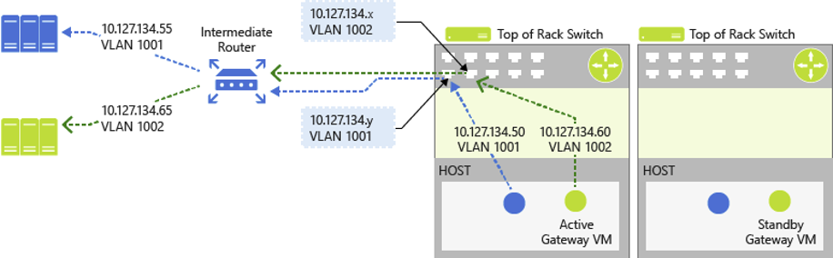
L3 Gateway example
Notes:
This diagram is an example CSP Virtual Network configuration as depicted in the illustration above.

Slide 48
Network connections resource (L3 forwarding)
Property | Description
ipAddresses | IP assigned in the tenant compartment for L3 interface.
ipAddresses.ipAddress | IP address for L3 interface in tenant compartment.
PeerIpAddress | Indicates peer IP address to which connection is made. Used by L3 interface.
routes.nextHop | Next Hop of the routes.
l3Configuration | Indicates details of L3 configuration.
l3Configuration.vlanSubnet | Reference to a logical subnet of L3 connection.

Slide 49
High availability for L3 forwarding Gateways
During failover, Gateway Manager selects one of the standby Gateways from pool and re-provisions the network connections and routing.
L3 Forwarding Gateway's L3 IP address is moved to the new Gateway.
Remote physical infrastructure will re-establish connectivity to the L3 IP address.
The BGP IP address is also moved during this operation.
If BGP routing is enabled, BGP connection will be re-established with route advertisement exchanged.
Notes:
The Gateway failures, failure detection, and the Gateway failover process in the context of an L3 forwarding Gateway is similar to the processes for IKEv2 and GRE RAS Gateways. The differences are in the way the external IP addresses are handled.
When the Gateway VM state becomes unhealthy, Network Controller selects one of the standby Gateways from the pool and re-provisions the network connections and routing on the standby Gateway. While moving the connections, the L3 forwarding Gateway's highly available CA space IP address is also moved to the new Gateway VM along with the CA space BGP IP address of the tenant.
Because the L3 Peering IP address is moved to the new Gateway VM during the failover, the remote physical infrastructure is again able to connect to this IP address and, subsequently, reach the Hyper-V Network Virtualization workload. For BGP dynamic routing, as the CA space BGP IP address is moved to the new Gateway VM, the remote BGP Router can re-establish peering and learn all Hyper-V Network Virtualization routes again.

Slide 50
Lab
Create the Gateway subnet​.
Create the virtual Gateway​.
Create the logical network and subnet​.
Create the L3 connection​.
Configure the Contoso-GW01 Gateway​.
Examine the Gateways and Gateway pools.
Examine the VFP policies applied to FABRIKAM-VM1.

Slide 51
Knowledge check – L3 forwarding Gateway
In what scenario is the L3 Gateway best for?
What is one complexity around the L3 Gateway that tenants and operators must account for?
Notes:
See answers at end of the deck.

Slide 52
Component tracing

Slide 53
Trace logging
As Gateway Service is part of the Network Controller, refer to the M2_Network_Controller module regarding trace logging settings.
ETW events will contain information related to goal state, health monitoring and resource configuration.

Slide 54
IKE logs
IKE logs have been updated to leverage TraceLogger to generate ETW events with Windows Server 2022.
In previous versions, events can only be decoded using internal Microsoft symbols.
ETW events are logged on the RAS Gateways and include data related to tunnel establishment and maintenance.
ETW traces are binary and must be decoded to make it human readable.
Need to be decoded by Netsh. For reliable decoding, needs to be decoded on the box where the trace was captured.

Slide 55
Common IKE error codes
Error code | Error reason | Action
13868 | ERROR_IPSEC_IKE_POLICY_MATCH | Make sure the policies match and the remote Gateway supports Any Traffic Selectors.
13801 | ERROR_IPSEC_IKE_AUTH_FAIL | Make sure the PSK (Pre-Shared Key) is properly set on both sides.
13805 | ERROR_IPSEC_IKE_TIMED_OUT | Negotiation timed out between the two devices. Investigate the remote VPN device and datapath between Azure Stack and remote VPN device. Verify UDP ports 500/4500 allowed.
13826 | ERROR_IPSEC_IKE_INVALID_SIGNATURE | Make sure the PSK is properly set between the 2 Gateways (failure point: local).
809 | ERROR_VPN_TIMEOUT | The remote Gateway is not responding.
Notes:
Here are some common error codes that will show up in the networkConnections object for tunnels using S2S IPsec tunnels.

Slide 56
Lab
Failover a RAS Gateway​.

Slide 57
Knowledge check – trace logging
If you are using Windows Server 2019, use NETSH TRACE CONVERT to decode the .etl files to understand why IKE authentication is failing.
Where can you find the logs related to Gateway Manager?
Notes:
See answers at end of the deck.

Slide 58
Resources
Gateways resource
VirtualGateways resource
networkConnections resource
GRE Tunneling in Windows Server 2016
RAS Gateway GRE Tunnel Throughput and Performance
What is RAS Gateway for Software Defined Networking?
RFC 4301 - Security Architecture for the Internet Protocol
RFC 4302 - IP Authentication Header
RFC 4303 - IP Encapsulating Security Payload (ESP)
RFC 7296 - Internet Key Exchange Protocol Version 2 (IKEv2)

Slide 59
Knowledge check answers (1/2)
Learning objective | Questions | Answers
1: Architecture | In what version of Windows Server was FastPath introduced? Which protocol is used to configure policies to the RAS Gateways? What is a Gateway pool?​ | Windows Server 2019 WinRM Consists of Gateways that provide S2S GRE, S2S IPSec and L3 services to tenants.
2. Virtual Gateways | What is a Virtual Gateway? You can only have a single Network Connection per Virtual Gateway? What route types exists? | Resource that contains the definition to enable cross-routing between virtual network and on-premises network. False Static and Dynamic (BGP)
3. S2S IPSec | What is one of the primary reasons to leverage S2S IPSec tunnel? What two tunnel types must be established before traffic can flow? Traffic for S2S IPSec tunnels are routed through the SLB MUXes. | Traffic is encrypted which is ideal when connecting locations across the public internet. Phase 1 (main) and Phase 2 (quick) True

Slide 60
Knowledge check answers (2/2)
Learning objective | Questions | Answers
4. S2S GRE | Traffic for S2S GRE tunnel must route through SLB MUXes. S2S GRE tunnels leverage encryption, enabling secure transit of data across the internet. | False False. S2S GRE tunnels within SDN do not leverage encryption natively.
5. L3 | In what scenario is L3 Gateway best for? What is one complexity around the L3 Gateway that tenants/operators must account for? | Traffic stays local within the datacenter. L2 configuration of the VLANs must be configured within the physical network.​
6. Tracing | If you are using Windows Server 2019, you can use NETSH TRACE CONVERT to decode the .etl files to understand why IKE authentication is failing. Where can you find the logs related to Gateway Manager? | False. You must engage Microsoft for assistance to decode the logs for IKE logs generated on systems prior to Windows Server 2022. On the NC node that is primary replica for Gateway Manager.

